Slide 1
Putting the Development of Talents Among Native American Youth on the National Agenda: Future Directions for Research, Partnerships and Practices
Marcia Gentry, Ph.D. & Jennifer Richardson, Ph.D.
Matt Fugate, Enyi Jen, & Jiaxi Wu, Doctoral Students
Stacey Folyer, GERI Administrative Assistant
William Byers, M.Ed., Retired Educator
Purdue University
mgentry@purdue.edu

Slide 2
Never doubt that a small group of thoughtful, committed citizens can change the world. Indeed, it is the only thing that ever has.
--unconfirmed

Slide 3
Addressing Needs
Intersecting Literature
Native American Studies (AI/AN)
Rural Schools
Gifted, Creative, and Talented Studies (N=20)
Underserved Populations
Culturally Responsive Practices
English Language Learners
Poverty
Special Needs (e.g., remedial, disability)

Slide 4
Native Americans in GCT Literature
Rarely addressed (See summary)
Little exists in recent years
Trend studies using NAEP data
Non-empirical
Lacks generalizability (a good thing?)
Frequently eliminated from large studies due to small numbers (e.g., Excellence Gap)

Slide 5
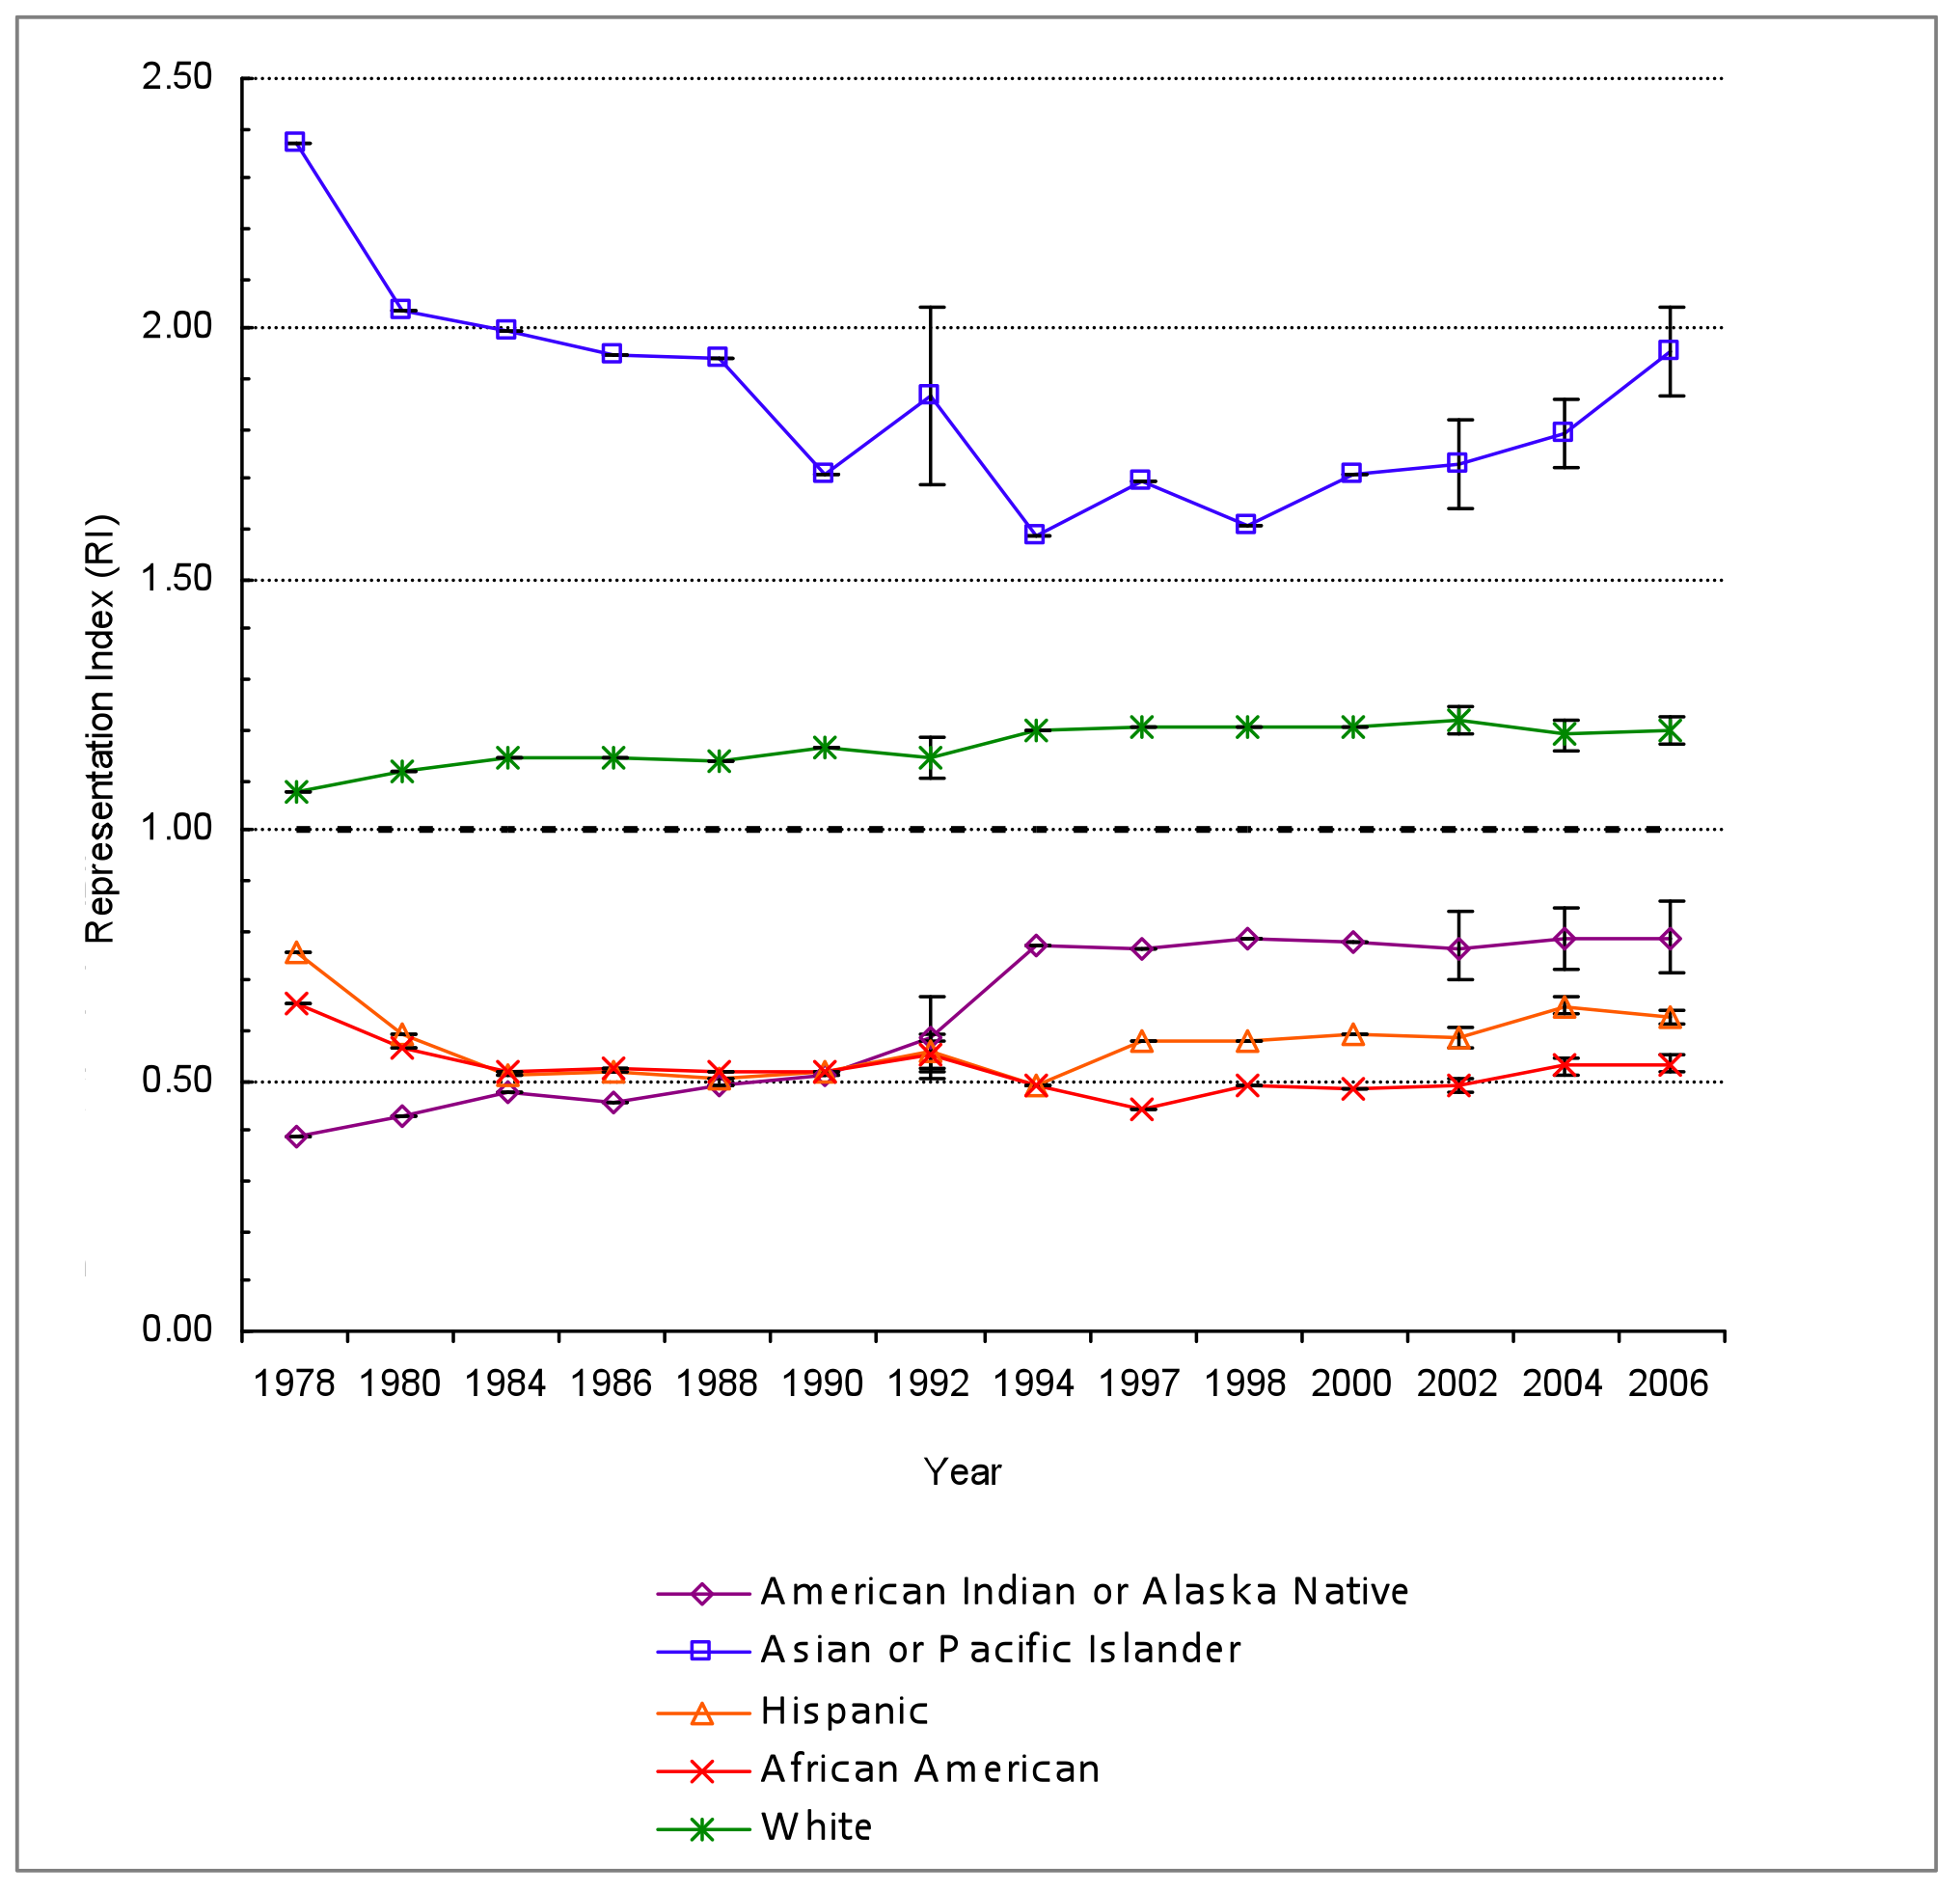
(Yoon & Gentry, 2009)

Slide 6
The Excellence Gap (Plucker et al., 2010)
“…an achievement gap exists at higher levels of academic performance. The economically disadvantaged, English Language Learners, and historically underprivileged minorities represent a smaller proportion of students scoring at the highest levels of achievement…The presence of an excellence gap is demonstrated both on national and state assessments …the proportion of all students (including more advantaged groups) that score at the highest level constitutes a relatively small share of all students…”

Slide 7
Poverty (Wyner et al. 2009)
3.4 million high-achieving students from low-income families
Over time, they are less likely than their non-low income peers to
Persist
Improve
Graduate HS
Attend college (or attend selective college)
Earn a bachelor’s degree
Achieve at highest levels

Slide 8
(Wyner et al., 2009)

Slide 13
Comprehensive Continuum of Gifted Education and Talent Development Services
Who are these children and how do we find them?
Will HOPE Scale help?
More is better (services, identification, areas of focus, efforts)
Strength-based is essential
General (GFAC) and GCT Services

Slide 14
Setting an Agenda
AERA SIG: Research on Giftedness, Creativity and Talent (priority)
Opportunity to set agenda and collaborate
Refine and update language and assumptions
Leverage resources and knowledge
Develop services
Create a research agenda that affects practices and services in an important way

Slide 15
Considerations: Reading and Analysis of Non-fiction framework (RAN)
A modification of the traditional KWL chart developed by Tony Stead (Reality Checks: Teaching Reading Comprehension with Non-fiction, 2006).
KWL charts are limiting:
They do not sufficiently support the research process
The do not take into account misinformation

Slide 16
The Process
What we think we know
Assumptions that are believed to be true
Yes, we were right!
Confirmation of assumptions
Misconceptions
Assumptions that should be disregarded

Slide 17
The Process
New Information
Additional information not stated in our assumptions that should be considered
Wonderings
Important research questions raised based upon the new information

Slide 18
Your Task
In small groups, consider the assumptions on your RAN charts:
Which are correct? Misconceptions?
What else should we consider?
What areas exist as potential partnerships for future research?

Slide 19
Assumptions: Talent Development
Talented youth exist among Native populations
Recognition, development, services, and programs are needed to nurture these youth
More youth can achieve at higher levels that current expectations indicate
specific considerations should be given to develop spiritualistic, naturalistic, leadership, visual/spatial, artistic, musical, creative problem solving, and communication (naat' aanii) strengths

Slide 20
Assumptions: Talent Development
Programs and curriculum should be tied to culture, and delivered according to learning preferences and cognitive styles of the students
Group work and solving relevant problems should be a focus
Early identification, enrichment programming, and on-going identification should be done in a variety of areas

Slide 21
Assumptions: Culture and Traditions
Collective society
Matriarchal society
Respect for authority and elders
Traditions and cultural knowledge are important to hand down to future generations
Oral traditions, ceremonies, and storytelling exist and are important

Slide 22
Assumptions: Culture and Traditions
Present, cyclical view of time is prevalent
Religion and spirituality are ways of life
Live in harmony with nature, non-materialistic
Patience and self-control are valued
Tribal leaders, spiritual leaders, and medicine people are valuable community members

Slide 23
Assumptions: Cognition and Learning
Public display of knowledge is not encouraged (humility)
Cooperative and sharing
Anonymity
Non-competitive, non-aggressive
Watch, learn, then do
Practice, hands-on, participation

Slide 24
Assumptions: Cognition and Learning
Spatial strengths
Simultaneous processing
Naturalistic, holistic views
Storytelling, auditory learning
Psychomotor, physical learning
Concern for accuracy over speed

Slide 25
Assumptions: Communication
Soft, slow speech, quiet, few interjections, delayed responses
Non-verbal communication emphasized
Indirect, non-verbal cues to speaker or listener
May be fluent in two or more languages
Introspective rather than questioning
Feelings unlikely to be openly expressed

Slide 26
References
Castagno, A. E., & Brayboy, B. M. J. (2008). Culturally responsive schooling for Indigenous youth: A review of the literature. Review of Educational Research, 74(4), 941-993.
Callahan, C. M., & McIntire, J. A. (1994). Identifying outstanding talent in American Indian and Alaska Native students. Washington, DC: OERI.
DeVries, M. & Golon, A. S. (2010). Making education relevant for gifted Native Americans: Teaching to their learning style. In J. A. Castellano (Ed.) Title of Book, 47-72. Waco, TX: Prufrock.
DeVoe, J. F., & Darling-Churchill, K. E. (2008). Status and trends in the education of American Indians and Alaska Natives: 2008. Washington, DC: National Center for Education Statistics. Retrieved from http://nces.ed.gov/pubs2008/2008084.pdf
Faas, L. A. (1982, June). Cultural and educational variables involved in identifying and educating gifted and talented American Indian children. Paper presented at the Gifted Minorities Conference, Tuscon, AZ.
Gentry, M. (2009a). A comprehensive continuum of gifted education and talent development services: Discovering, developing, and enhancing young people’s gifts and talents. Gifted Child Quarterly.
Gentry, M. & Mann, R. L. (2008). Total school cluster grouping: A comprehensive, research-based plan for raising student achievement and improving teacher practices. Mansfield Center, CT: Creative Learning Press.

Slide 27
References
Grigg, W., Moran, R., and Kuang, M. (2010). National Indian Education Study - Part I: Performance of American Indian and Alaska Native Students at Grades 4 and 8 on NAEP 2009 Reading and Mathematics Assessments (NCES 2010–462). National Center for Education Statistics, Institute of Education Sciences, U.S. Department of Education, Washington, D.C.
Hartley, E. A. (1991). Through Navajo Eyes: Examining differences in giftedness. Journal of American Indian Education, 31 (1), 53-64.
Herring, R. D. (1996). The unrecognized gifted: A more humanistic perspective for Indigenous students. Journal of Humanistic Education and Development, 35(1), 4-11.
Knutson, K. A., & McCarthy-Tucker, S. N. (1993, April). Gifted Education for Native American Students: A State of Affairs. Roundtable presentation at the Meeting of the American Educational Research Association. Atlanta, GA.
Lohman, D. F. (2006). Identifying academically talented minority students (Research Monograph RM05216). Storrs, CT: The National Research Center on the Gifted and Talented, University of Connecticut.
Mead, N., Grigg, W., Moran, R., and Kuang, M. (2010). National Indian Education Study 2009 - Part II: The Educational Experiences of American Indian and Alaska Native Students in Grades 4 and 8 (NCES 2010–463). National Center for Education Statistics, Institute of Education Sciences, U.S. Department of Education, Washington, D.C.

Slide 28
References
Montgomery, D. (2001). Increasing Native American Indian involvement in gifted programs in rural schools. Psychology in the Schools, 38(5), 467-475.
Omdal, S., Rude, H., Betts, G., & Toy, R. (2010). American Indian students: Balancing Western and Native giftedness. In J. A. Castellano & A. D. Frazier (Eds.), Special populations in gifted education: Understanding our most able students from diverse backgrounds. (pp. 73-97). Waco, TX US: Prufrock Press.
Peterson, J. S. (1999). Gifted--through whose cultural lens? An application of the postpositivistic mode of inquiry. Journal for the Education of the Gifted, 22(4), 354-383.
Plucker, J. A., Burroughs, N., & Song, R. (2010). Mind the (other) gap: The growing excellence gap in K-12 education. Bloomington, Indiana: Center for Evaluation and Education Policy, Indiana University.
Plucker, J. A. & Callahan, C. M. (2008). Critical issues and practices in gifted education (pp. 669-680). Waco, TX: Prufrock.
Peterson, J. S. (1999). Gifted—through whose cultural lens: A post-positivistic mode of inquiry. Journal for the Education of the Gifted, 22, 345-383.
Reis, S. M., Burns, D. E., & Renzulli, J. S. (1992). Curriculum Compacting: The complete guide to modifying the regular curriculum for high ability students. Mansfield Center, CT: Creative Learning Press.

Slide 29
References
Reis, S. M., McCoach, D. B., Coyne, M., Schreiber, F. J., Eckert, R, D., & Gubbins, E. J. (2007). Using planned enrichment strategies with direct instruction to improve reading fluency and comprehension: An evidenced-based study. Elementary School Journal, 108(1), 3-23. Renzulli, J.S., Gentry, M., & Reis, S.M. (2003) Enrichment clusters: A practical plan for real-world, student-driven learning. Mansfield Center, CT: Creative Learning Press.
Renzulli, J. S. & Reis, S. M. (1997). The schoolwide enrichment model: A how-to guide for educational excellence. Mansfield Center, CT: Creative Learning Press.
Robinson, A., Shore, B. M., & Enerson, D. L. (2007). Best practices in gifted education. Waco, TX: Prufrock.
Romero, M. K. (1994). Identifying giftedness among Keresan Pueblo Indians: The Keres study. Journal of American Indian Education, 34(1), 35-58.
Sarouphim, K. M. (2002). DISCOVER in high school: Identifying gifted Hispanic and Native American students. Journal of Secondary Gifted Education, 14(1), 30-38.
Sarouphim, K. M. (2004). DISCOVER in middle school: Identifying gifted minority students. Journal of Secondary Gifted Education, 15(2), 61-69.
Tonemah, S. A. (1987). Assessing American Indian gifted and talented students’ abilities. Journal for the Education of the Gifted, 10(3), 181-194.
Tonemah, S. A. (1991). Philosophical perspectives of gifted and talented American Indian education. Journal of American Indian Education, 31(1).

Slide 30
References
Turner, S. L., & Lapan, R. T. (2003). Native American Adolescent Career Development. Journal of Career Development, 30(2), 159-172.
Wyner, J. S., Bridgeland, J. M., & DiIulio, Jr., J. J. (2009). Achievement trap: How America is failing millions of high-achieving students fromlower-income families (rev ed.). Lansdowne, VA: Jack Kent Cooke Foundation and Civic Enterprises. http://www.jkcf.org/news-knowledge/research-reports/
Yoon, S. & Gentry, M. (2009). Racial and ethnic representation in gifted programs: Current status of and implications for gifted Asian American students. Gifted Child Quarterly, 53, 121-136.

Slide 31
Links
www.purdue.edu/geri
www.gifted.uconn.edu
www.hoagiesgifted.org
www.nagc.org
www.aeragifted.net
http://ceep.indiana.edu/mindthegap/

Slide 32
Links
http://nces.ed.gov/nationsreportcard/pubs/studies/2010462.asp
http://nces.ed.gov/nationsreportcard/pubs/studies/2010463.asp
http://www.civicenterprises.net/pdfs/jkc.pdf
www.nationdeceived.org

Slide 33
If we are to achieve a richer culture, rich in contrasting values, we must recognize the whole gamut of human potentialities, and so weave a less arbitrary social fabric, one in which each diverse human gift will find a fitting place.
--Margaret Mead

